Slide 1
UNM Finance 101

Slide 2

Welcome – Let’s get started
So, you’re new to UNM or just new to the Finance arena. I will be your tour guide!
Let’s get started with the basics – “What is an index?”
An index is a 6 digit unique account set up for a specific purpose.
How do we make sure the index is unique? We use FOPAL elements to build the index:
F – FUND – the “bucket of money” that the funds belong to
O – ORGANIZATION – the department/group that the funds belong to
P – PROGRAM – the mission specific program the funds will correlate to
A – ACTIVITY – what type of activity are the funds for – can be created to generate a unique index if the F.O.P. elements are identical to a previous index
L – LOCATION – not currently used by UNM
Let’s get into each element now!
Here is a link to the Standard Accounting Resource Manual that UNM uses to guide our Financial and Accounting practices.
http://sarm.unm.edu/index.html

Slide 3
FUND
Fund Types. To further differential funds for reporting purposes, funds are divided into fund types. General fund types include:
Unrestricted Funds – resources that are currently expendable for any purpose toward performing the primary objectives of the University: Instruction, Research, Public Service and Supporting Services. Unrestricted funds include all funds received for which no stipulation was made by donor or other external agency as to the purposes for which they should be expended. The use of these funds is governed by and must comply with administrative policies such as UNM Business Policy, as well as state and federal legislation.
Restricted Funds – resources that are available for operations that are limited by granting and other external agencies to specific purposes, program, department or schools.
Endowment Funds - donated funds that are invested. Normally only the income earned on endowments may be spent. An earning formula is applied to invested funds to determine the amount available for spending.
Non-Endowed Funds - donated funds that are available to be spend within the guidelines established by the donor.
Plant Funds – funds to be used for the acquisition of properties; funds restricted or designated for retirement of indebtedness.
Loan Funds – include resources available for and transaction related to loans to students.
Agency Funds – are amounts deposited with the University by organizations for which the University acts as fiscal agent.

Slide 4
FUND
There are four designations of funds – but the main ones are Restricted and Unrestricted. You can tell the difference because Unrestricted funds will always have a “U” after the first digit. The first digit is based on the location of the fund – “2” is for main campus and “3” is for HSC
(it is doubtful you would need these but “4” is for Gallup Campus, “5” is for Los Alamos Campus, “6” is for Valencia Campus, “7” is for Taos Campus)
The second character of a fund indicates the type of fund.
Unrestricted - U Restricted – alpha-numeric Endowment - E Plant – P
An example of Unrestricted would be 2U0224 which is Main Campus’ primary Instructional & General fund (I&G) or 3U0044 which is HSC Campus’ primary I&G fund.
An example of a Restricted fund would be 3FC50. This funds belongs to Grant 3RFC5. The R is for restricted and the 3 is for HSC campus.
An example of Endowment fund would be 3E515 – the TRU Baker Endowment, the Endowed Funds also have special Program codes that would look like P3E for the HSC.
Non-Endowed funds go into 3U0002 but a special Program Designation – P3N for HSC funds.

Slide 5


What does UNM provide?
UNM provides educational services in the following general categories:
Instruction. The primary educational service is instruction. The university conducts classes for over 32,000 students each year. UNM offers 215 active degree and certificate programs. There are 94 baccalaureate, 72 masters, and 38 doctoral level degree programs. In addition to these programs, we offer 3 doctorial professional practice programs—in law, medicine, and pharmacy—as well as 4 education specialist certificates (graduate programs beyond the masters level), 8 graduate certificate programs, 2 undergraduate certificate programs, and 1 associate degree program in locations across New Mexico.
Research Services. UNM also conducts ongoing research for the public and private sector. These research projects provide educational activities for students, and serve to enhance the curriculum and instruction at UNM while meeting important research needs.
Clinical Services. UNM Health Sciences Center (HSC) provides an opportunity for all New Mexicans to obtain an excellent education in health sciences. HSC advances health sciences in the most important areas of human health with a focus on priority health needs of our communities.
Support Services. UNM provides business services to support University operations and to benefit the local community.
Sources of Funding. The following are examples of sources of funding that support UNM educational services:
The State of New Mexico. The State of New Mexico funds most of the instruction functions. During each legislative session, the state appropriates funds for the next fiscal year.
Research Sponsors. Both public and private organizations provide research grants.
Donors. Individual and corporate donors contribute gifts, scholarships endowments, etc., to support specific departments, schools, or activities. These valuable sources of income help UNM expand and enhance UNM and HSC services.
Revenue Generating Services. Some services provided by UNM generate revenue. These services are offered for a fee and typically do not depend on other sources of funds. Auxiliary services at UNM include such services as UNM Bookstore and certain entertainment events, like athletics and theatre. University Hospital (UH) and HSC clinics generate revenue for medical services rendered.

Slide 6

FUND – relates to the source of the revenue (“Bucket”)
At UNM, we have a wide variety of funding sources.
We generate clinical revenue for our clinical activities
We receive funding from the state of NM for based on the formula funding model due to student attendance
We receive special funding from the state in the form of a State Appropriation or RPSP (research and public service projects) like funds for the expanded GME residents or state funding from a special bill like SB1 in 2022. State Appropriations can come to UNM as recurring operating funds, non-recurring (one-time) Operating funds, or Capital funds. These funds are received for specific purposes and have guidelines that must be followed based on the language of the appropriation.
We generate funds from student fees
We receive a gift from a donor that wants to give back to the community or an alumni that wants to help future SOM students
We generate Facilities & Administrative (F&A) fees from our contracts and grants that support operations
Types of funds
Clinical Revenue
SRMC Hospital Operations 3U0087
CRTC Billing 3U0064
HSC I&G – 3U0044
State Appropriations
Research State Appr - 3U0083
Clinical Public Services State Appr – 3U0085
Student Fees – 3U0080
Endowed Spending Research – 3U0081
F&A – 3U0047

Slide 7

FUND
You may be wondering – why does the Fund matter, isn’t money just money.
For UNM, the unrestricted funds are not necessarily without restrictions. The different funds have their own limits on what the funds can and cannot be used for.
One example would be that you cannot use University funds to pay for a table sponsorship for an event. Only Foundation funds can be used for that.
Another example – incentives should not be charged to I&G.
Alcohol and lobbying charges cannot be charged to State Appropriations
The Big Three Funds correlate to our missions:
I&G - Education
Public Service
Research
Expenses are allowable as long as they benefit the University and the University’s mission.
As a major public institution funded in part by state allocations and student tuition, the University of New Mexico is held to a high level of accountability for its business practices. All expenditures of University funds should clearly and directly support the University’s mission of teaching, research, patient care, and community service.

Slide 8
FUND
The source of funding (state appropriated I & G, Public Service, Research, gifts from donors, etc.) expected to be used for a proposed expenditure is not the determining factor as to whether the expenditure is allowable under policy. University Business Policy #4000 "Allowable and Unallowable Expenditures", section 2 "Scope of University Funds" states: "It is the general policy of the University that all financial resources received by the University irrespective of their sources, shall be expended under common policy and procedures. All funds made available to the University shall be expended through University accounting systems and in accordance with University Business Policies and Procedures. This includes funds obtained through the appropriation of tax revenues, gifts from individual donors, income earned for services rendered such as research and public sources, or through transfers from affiliated organizations such as foundations..." In fact, there may be tighter restrictions on the usage of funds from some sources, specifically I&G and Endowed/Non-endowed, than policy generally allows. Donors generally specify the type of expenditures for which they intend their donations to be used. However, if a particular expenditure does not comply with policy, regardless of the donor intent, it will not be allowed.
When in doubt, please contact the appropriate Financial Services accounting office BEFORE initiating the transaction. As always, any payment must have a valid UNM business purpose, which must be fully explained on the document (Chrome River, Purchase Requisition, Journal Voucher, etc.). Do not just restate what is being purchased.
http://sarm.unm.edu/part-1/basic-concepts/1-e-banner-concepts-and-definitions.html

Slide 9
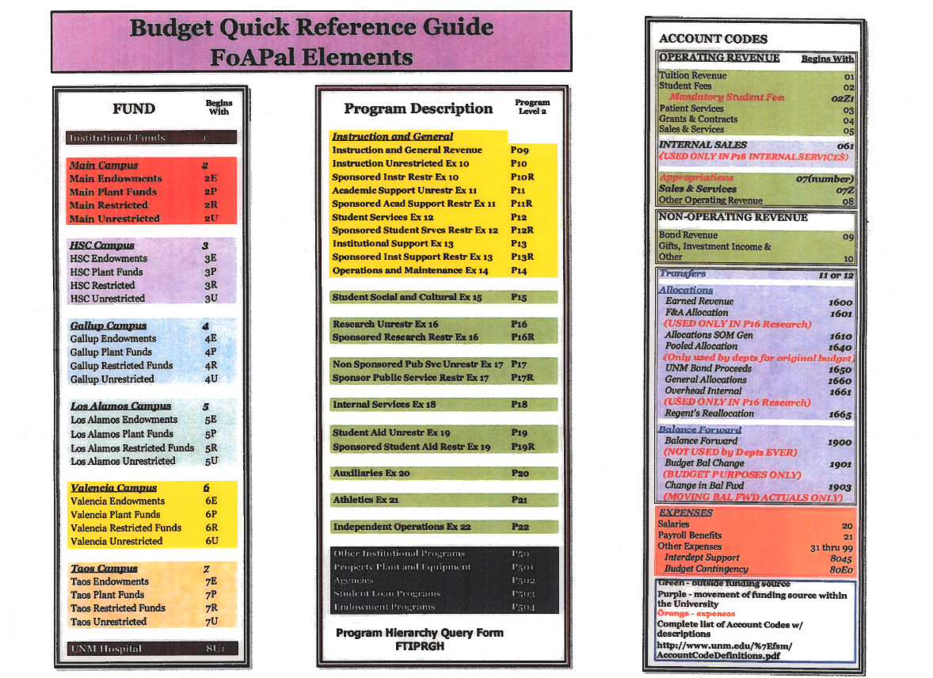
Quick Reference Guide
UNM Account Codes (as of 2/18/26)
https://ua.unm.edu/resources/oplegacctdef-02-18-26.pdf
Other Institutional Programs P50
Property Plant and Equipment P501
Agencies P502
Student Loan Programs P503
Endowment Programs P504
UNM Hospital 8U1

Slide 10
Organization
The Organization code is used to track financial activities by functional reporting unit such as campus, college, school, department, division, and cost center. The hierarchy UNM has created includes the following structure:
Organization Level 1: President (highest level of reporting) Organization Level 2: Campus/Vice President Organization Level 3: College/School Organization Level 4: College Grouping (determined by Level 3 Administrator) *Organization Level 5: Department (determined by Level 3 or 4 Administrator) Organization Level 6: Division (optional, determined by Level 5 Administrator) Organization Level 7: Unit (optional, determined by Level 6 Administrator) Organization Level 8: Sub-unit (optional, as necessary)
The organization represented in the Index is where the financial activity is reflected and this activity will also roll up into the financial reports of the higher levels of organizational reporting within the structure. An organization is a permanent unit with assigned employees and an operating budget. Each organization has an “organization financial manager” identified within the Banner system. The organization structure within Banner may mirror the organizational and reporting chart that is used within each unit as a tool or method to review and report on the financial results of each unit’s manager
*Organization 5 – is where most of what we do is – this is the overarching departmental organization

Slide 11

Organization
Organization refers to the department/unit involved and the breakdown of the Organization is like an Umbrella with the Level 5 Organization at the top encompassing everything and then levels beneath it that tie back to the Level 5 Org.
All of our Level 5 Organizations have a 3-digit prefix followed by the Letter A to designate Organization it is. The Level 6 Organization designates a Division within that Organization. The Level 7 Organization further breaks down the Division to into specific elements to keep certain activities separate. The Level 5 Org is also known as the “Home Org” – this is handy for figuring out which department a faculty member was hired into.
Org 5 example – 997A – Pediatrics– the level 5 is entire Pediatrics Department
Org 6 example – 997P – Pediatrics Nephrology – a specific division in Pediatrics
Org 7 example – 997P01 – Nephrology Faculty #02

Slide 12
Program
The Program assigned to each index represents specific reporting requirements established by the State of New Mexico Higher Education Division (HED) to which the University must adhere. The program designated indicates the functional classification, such as Instruction, Research or Public Service. For additional flexibility in reporting, the UNM COA program structure is also hierarchical:
Program Level 1: Mission Program Level 2: Functional Classification (Restricted/Unrestricted) Program Level 3: Program or Project
The program assignment for Sponsored (Restricted) Projects is designated based on the classification of the award as administered by the Contract and Grant Administrative (core) offices. The program assignment for unrestricted projects is determined by the Budget Offices responsible for reporting to HED. Within the hierarchy structure, the fund assignment and the program assignment that an index receives should been consistent as they both refer to the overall mission of the University.

Slide 13

PROGRAM
The programs that tie back to the mission are grouped together.
P17 level 2 program code relates to Public service. Then when we add the next character, it further designates the program that is being supported.
P17C – Public Service Contracts
P177 – State Appropriation Newborn Intensive Care
P17U – UH Clinical Operations
P16 level 2 program code relates to Research.
P12 level 2 program code relates to Student Services, including self-supporting.
P18 is for Internal Service Centers.
P3N is for non-endowed funds for HSC, P2E is for non-endowed funds for Main Campus.
P3E is for endowed funds for HSC, P2N is for endowed funds for Main Campus.

Slide 14
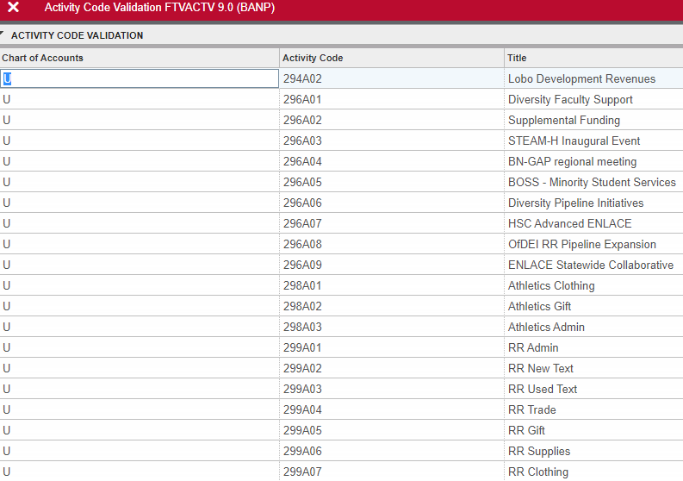
ACTIVITY
When you go to create and index, it is highly likely that your organization already has an index with the Fund, Org, and Program code you intend to use.
So how do I make the new index and make it unique?
The answer is the Activity Code.
The Activity Code can be generated in the Chart of Accounts (COA) system and be as unique as needed in order to give the new index a different FOPAL element so it is separate from other indices. The next slide will show the COA application. You will use the TITLE to have the system generate a new Activity Code.
The standard Activity Code is GNACTV which is for general activity. But once that is used, a new activity code will need to be created.

Slide 15
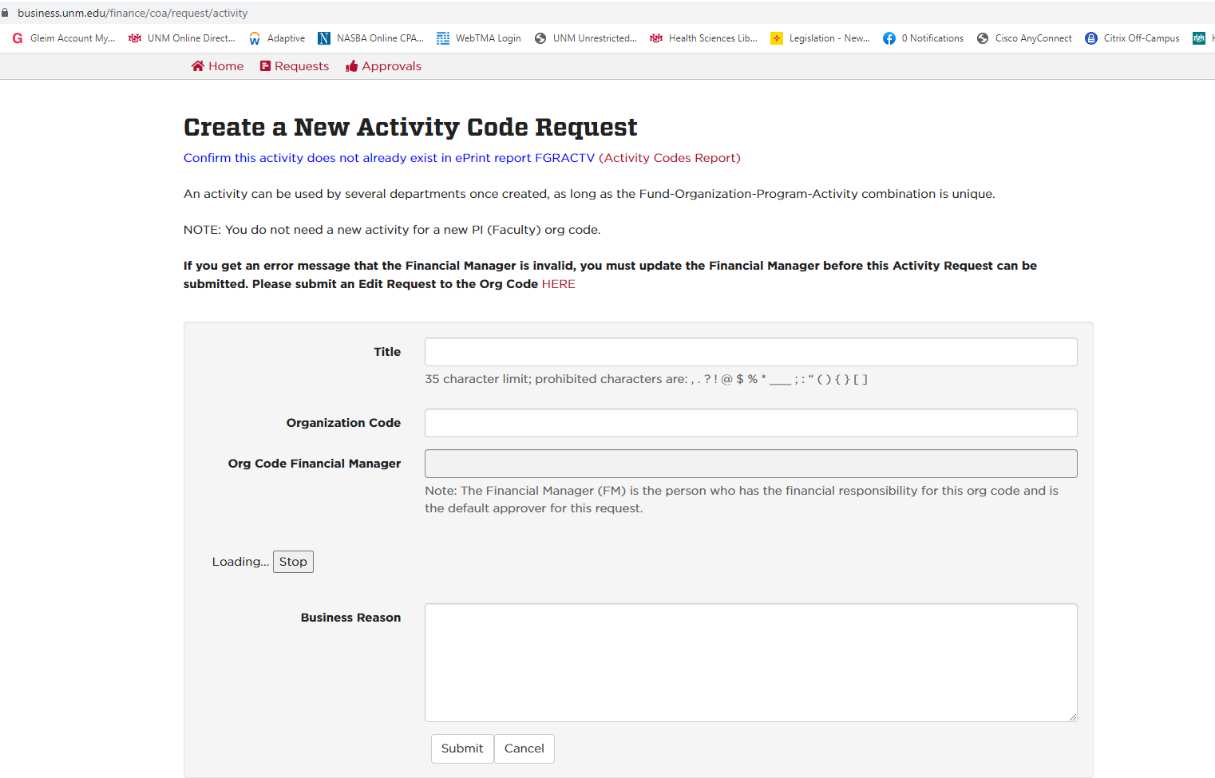
ACTIVITY
Using the Chart of Accounts Application, you can request a new activity code based on the title of what the purpose of the new index will be – i.e. RR Pipeline. Once the Activity code is generated, you will be able to create a new index using the Chart of Accounts Application.

Slide 16
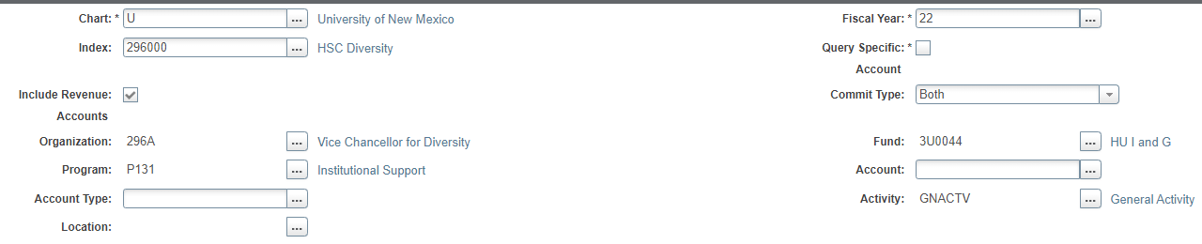
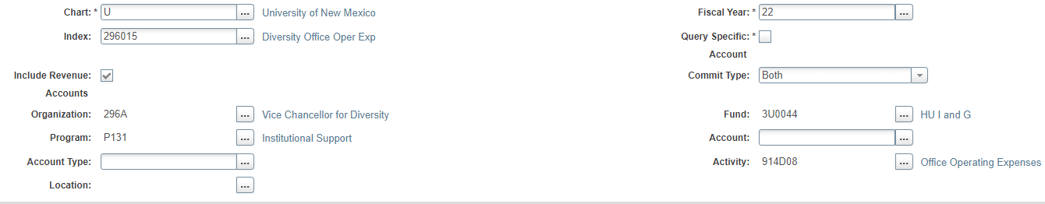
ACTIVITY
Notice how the Organization, Program, and Fund are all the same – so to create another index, the Activity had to be generated to be unique

Slide 17
The various types of expenses in Banner
In order to process purchases/expenses, UNM has a variety of ways this can be accomplished.
A UNM P-card can be used in store or online
A person may go into the Bookstore and purchase an item using a UNM index code
A Chrome River reimbursement can be done to reimburse someone for items they purchased on behalf of the University or as a reimbursement for travel
A Purchase Order agreement can be setup and then the expense posted as an Invoice once the goods are received or services performed
UNM IT/Telecom directly charge an index for telecom items like desk phones, long distance, UNM issued cell phones or internet service for tablets
Once these items post – they get a DOCUMENT number – each document number is unique to that transaction. The different types of expenses are indicated by the Document number.

Slide 18

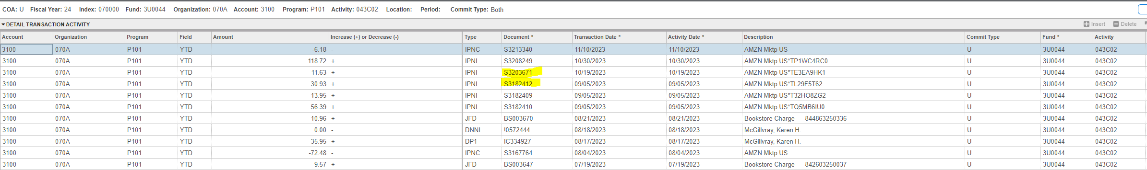
What type of document is it and where can I find it?
When you are in an index in Banner, you will see transactions that have posted. The items you see in Banner upload into Myreports overnight so they should match for the most part.
How do you know what kind of expense you are looking at and how it was processed?
Each type of expense will have its own document type.
P-card – start with the letter S and has 7 numbers after it. These items will have been processed through Chrome River after using the UNM P-card. The Description tells you who the vendor is that we purchased from.
Below is a snip from Banner when you are looking in an index and drill down into a specific account code. You can see the Document numbers and I have highlighted in yellow an example of a P-card transaction

Slide 19
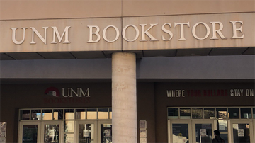
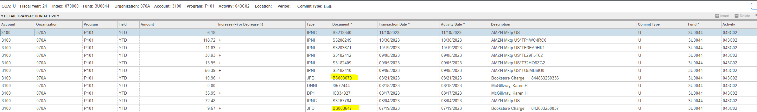
What type of document is it and where can I find it?
Each type of expense will have its own document type.
Bookstore – will start with the letters BS and have 6 numbers after it. These items will have been purchased directly from the UNM Bookstore – not through a P-card or Purchase Order. The digits in the description will also be found on the receipt from the Bookstore.
Below is a snip from Banner when you are looking in an index and drill down into a specific account code. You can see the Document numbers and I have highlighted in yellow an example of some Bookstore transactions

Slide 20

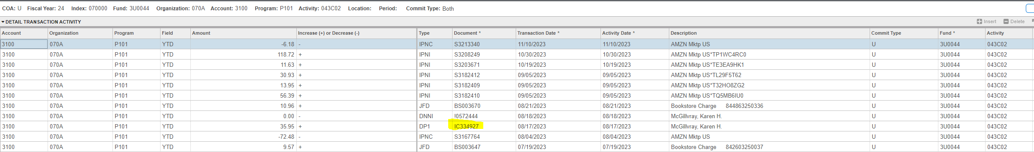
What type of document is it and where can I find it?
Each type of expense will have its own document type.
Chrome River Reimbursement– will start with the letters IC and have 6 numbers after it. These documents will have been processed through Chrome River as an expense – could be to reimburse and employee for travel or something they purchased but can also reimburse students or non-UNM people. The description tells you who we are reimbursing. Chrome River could then give you the details of the expense.
Below is a snip from Banner when you are looking in an index and drill down into a specific account code. You can see the Document numbers and I have highlighted in yellow an example of a Chrome River Reimbursement transaction.

Slide 21
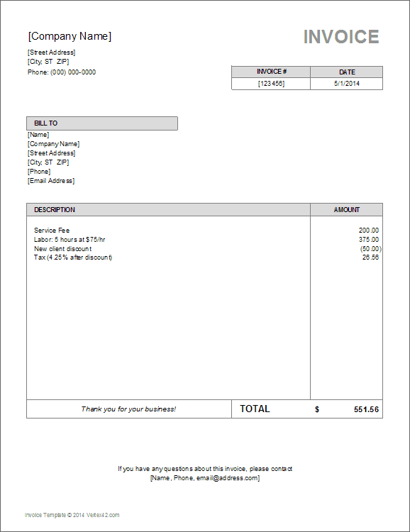
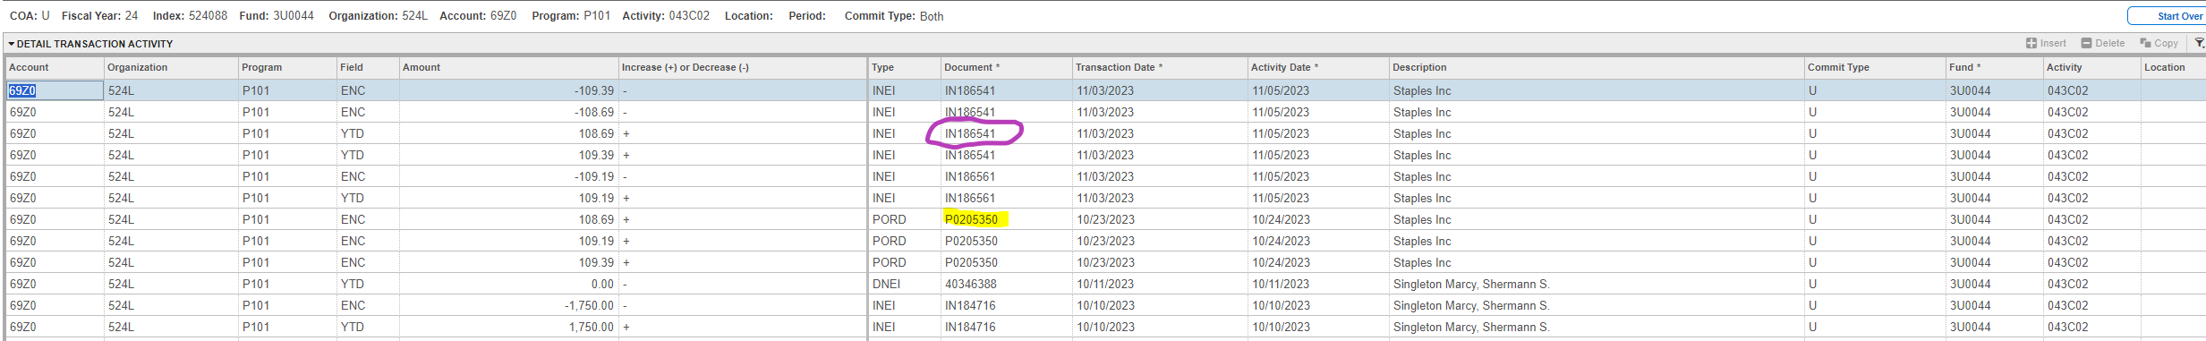
What type of document is it and where can I find it?
Each type of expense will have its own document type.
Invoice from a Purchase Order - the invoice process is different as it starts in Lobomart as a Requisition. Once the Purchasing department approves the Requisition, the anticiapted expense becomes a Purchase Order and is issued a PO Number – these start with the Letter P and have 7 digits after (P0205350). A Purchase Order only ENCUMBERS the cost to the index – it does not CHARGE the index with the expense. That is what INVOICE is. We should only process invoices in Lobomart when the goods have been received or services have been provided. Invoices begin with the Letters IN and have 6 digits after (IN186561). You can see the life cycle of a purchase order and invoice in Lobomart.
Below is a snip from Banner when you are looking in an index and drill down into a specific account code. You can see the Document numbers and I have highlighted in yellow an example of a Purchase Order transaction. I have circled in purple the Invoice example.

Slide 22

What type of document is it and where can I find it?
Each type of expense will have its own document type.
Telecom Charges– will start with the letters IT and have 6 numbers after it. These expenses will process as Journal Vouchers from the IT/Telecom department and you will have to look in the Telecom portal or contact IT for details on the expense.
Below is a snip from Banner when you are looking in an index and drill down into a specific account code. You can see the Document numbers and I have highlighted in yellow an example of a Telecom transaction.

Slide 23
What is a Journal Voucher – JV?
A Journal Voucher is a way to move either revenue or an expense from one index and account code to another index and account code. These can be identified by their document number as it starts with the Letter J and has 7 digits behind it. There are a variety of TYPES of JVs and those relate to departments and who is creating them. The one most used is JE2 and that moves an expense from one place to another. The way revenue is moved is discussed later as an allocation or transfer.
When an expense transaction posts in Banner, it posts as a DEBIT to the index and account code. Keep this in mind for the next slide

Slide 24
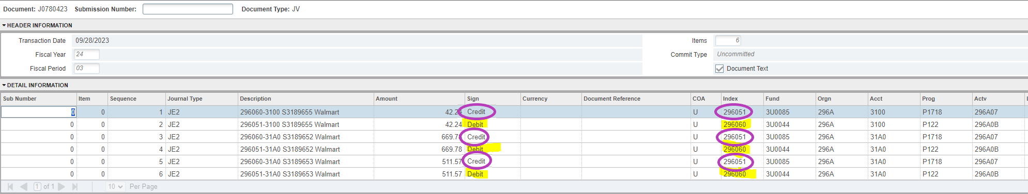
What is a Journal Voucher – JV?
While reconciling your indices you realize that you posted a P-card charge from Walmart to the wrong index when you processed/reconciled the expense in Chrome River.
Your expense posted to 296051 but it should have posted to 296060
You will use either FGAJVCQ in Banner or the Journal Document form in Loboweb to process this Journal Voucher to move the expense.
Because the expense posted to 296051 – you will CREDIT 296051
Because the expense needs to be in 296060 – you will DEBIT 296060

Slide 25
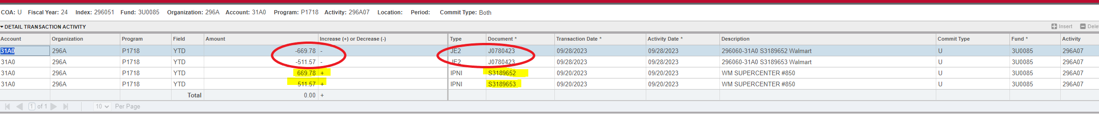
What is a Journal Voucher – JV – CREDIT side
Because the expense posted to 296051 – you will CREDIT 296051
As you can see below, the charge posted to 296051 originally with the P-card number (highlighted in yellow)
When we processed a JV to move the expense out of 296051 and to 296060, you can see the JV number and that the amount is negative which indicates it was moved out of that index and account code (circled in red)

Slide 26
What is a Journal Voucher – JV – DEBIT side
Because the expense needs to be in 296060 – you will DEBIT 296060
When we processed a JV to move the expense into 296060, you can see the JV number and that the amount is positive which indicates it was moved out of that index and account code (circled in green)
The original P-card charge and S document number are not seen when you do a JV so that is why the Description of the JV is so important. You need to briefly tell the person looking at it what was moved and from where. The document text is where the more detailed notes of why a JV was needed goes.

Slide 27
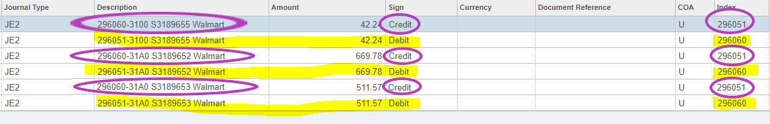
What is a Journal Voucher – JV – DESCRIPTION
The original P-card charge and S document number are not seen when you do a JV so that is why the Description of the JV is so important. You need to briefly tell the person looking at it what was moved and from where. The document text is where the more detailed notes of why a JV was needed goes. In the document text, you need to include the who, what, and why a JV is needed.
Because the expense posted to 296051 – you will CREDIT 296051
So the description is where you are moving the expense TO, the document number and anything else you can add to identify the transaction
Because the expense needs to be in 296060 – you will DEBIT 296060
So the description is where you are moving the expense FROM, the document number and anything else you can add to identify the transaction

Slide 28
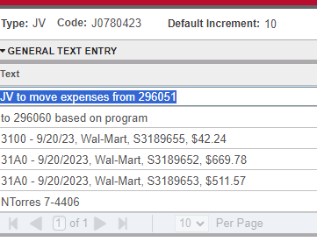
What is a Journal Voucher – JV – DOCUMENT TEXT
The original P-card charge and S document number are not seen when you do a JV so that is why the Description of the JV is so important. You need to briefly tell the person looking at it what was moved and from where. The document text is where the more detailed notes of why a JV was needed goes. In the document text, you need to include the who, what, and why a JV is needed.

Slide 29

How do you move Revenue?
Revenue is received a variety of ways in the University but let’s say you need to move money from one of your indices to another or you are providing support from one index to another for an event or a student group – How would you move revenue?
Revenue is moved as either an allocation or a transfer and we will go into this further in the coming slides

Slide 30

ALLOCATION or TRANSFER?
You have funds in an index and you need to move it to another index. How do you do this?
First you have to determine if it is an ALLOCATION or if it is a TRANSFER. While the names can have similar definitions and be interchangeable, in our Banner system, they are distinct and separate.
An Allocation is moving funds between indices that have the SAME fund type level 2 and the SAME fund level 2.
A Transfer using only the 11XX codes is between funds that are similar but not identical. They have SAME fund type level 2 and the but have a different fund level 2.
A Transfer using both the 11XX and 12XX codes is between funds that are completely different. They will most likely not share any FOPAL elements. They have different fund type level 2 and have a different fund level 2.
ALLOCATION
TRANSFER
Budget Office SOP – Allocation vs Transfer
BR103BudgetActualTransfer.pdf
*includes the business rules for allowability – for instance transferring in/out of endowed indices must have an approved exception*

Slide 31
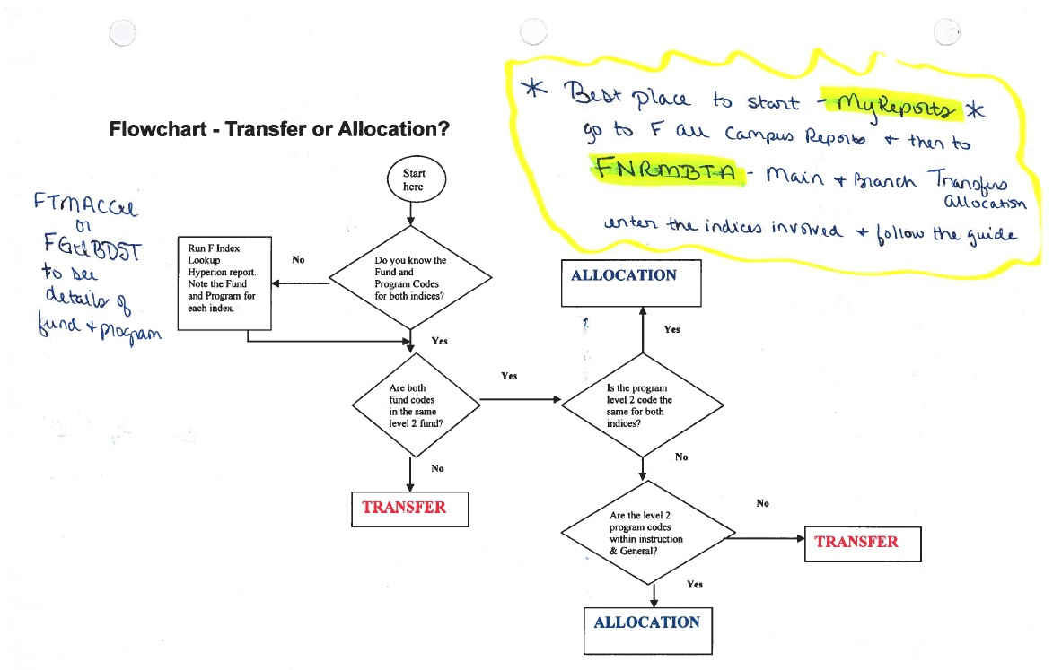
Allocation or Transfer?

Slide 32
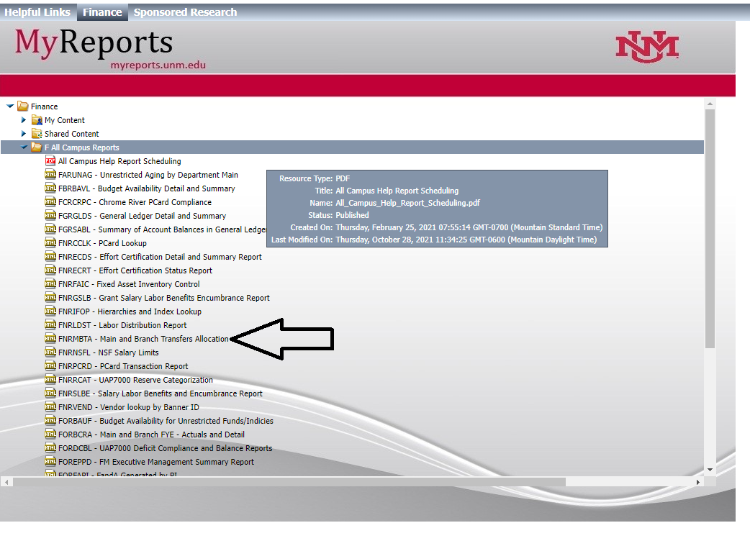
Allocation or Transfer?

Slide 33
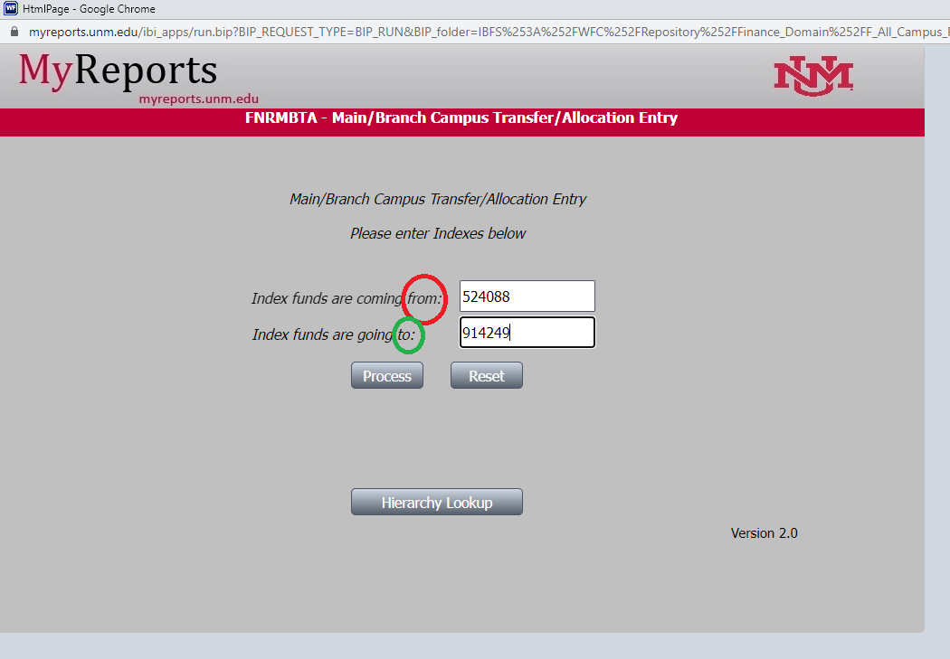
Allocation or Transfer?
Make sure to enter where the funds are coming FROM and where they are going to. If your department is giving money to another department – you are the FROM and they are the TO.

Slide 34
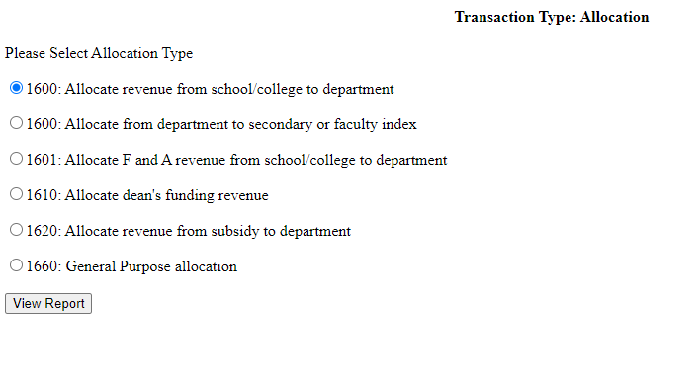

Allocation or Transfer?
If the money is moving between indices that are similar – they are in the same fund and have the same fund type level 2, then it will be an allocation and this screen will come up giving you options for the allocation type.
It is like APPLES TO APPLES

Slide 35
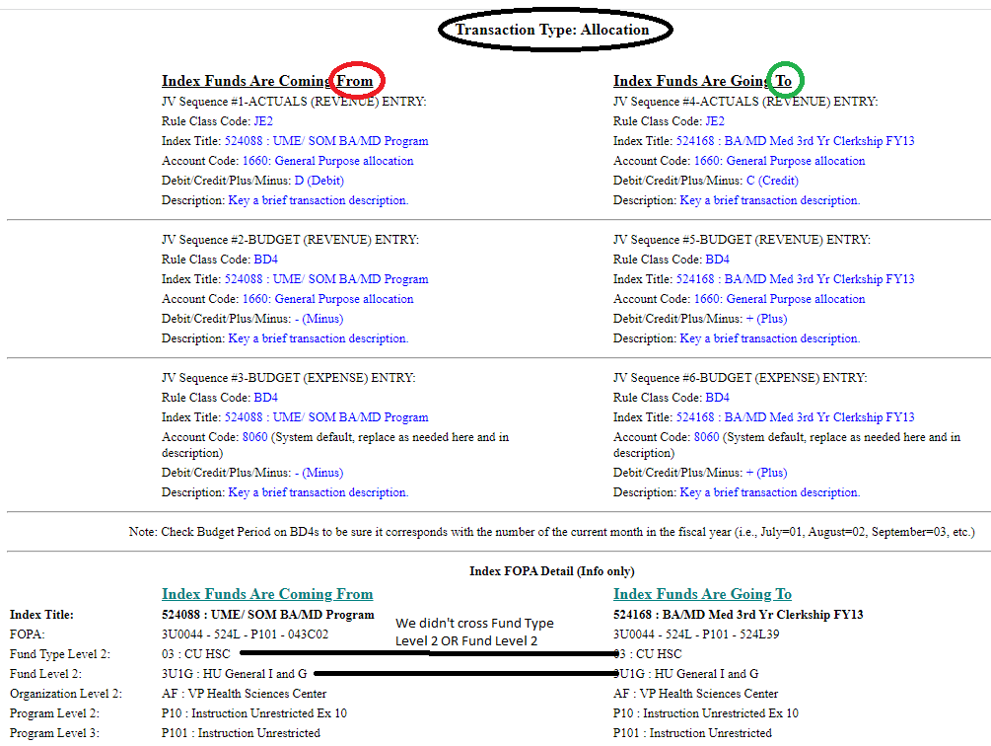
Allocation or Transfer?
Once you enter the indices and hit “Process”, this screen will come up. Notice how the top says it is says it is an ALLOCATION. That is because we are NOT crossing FUNDS at the Level 2 OR crossing the FUND Type Level 2. These funds are similar so it is an allocation versus a transfer.

Slide 36
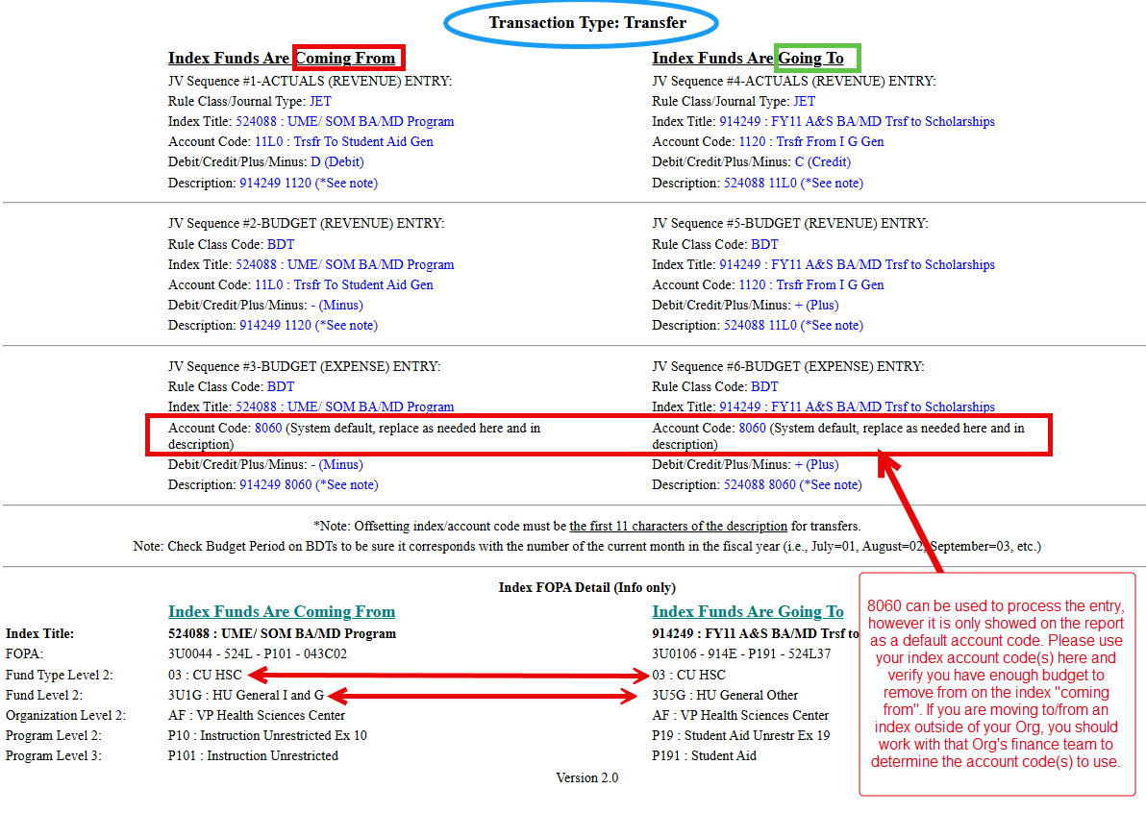

Allocation or Transfer?
Once you enter the indices and hit “Process”, this screen will come up. Notice how now the top says it is a TRANSFER. That is because we are crossing FUNDS at the Level 2 – but NOT crossing the FUND Type Level 2 – the codes for both sides will start with an 11XX. In this example, we are transferring from I&G to Student Aid.
A Transfer between similar funds is like APPLES TO ORANGES – still a fruit but not the same family

Slide 37
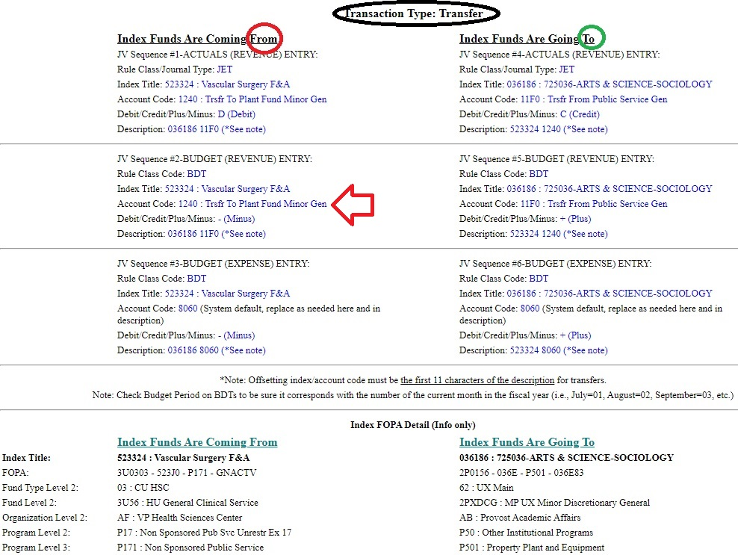

Allocation or Transfer?
Once you enter the indices and hit “Process”, this screen will come up. Notice how now the top says it is a TRANSFER. Notice how NONE of the FOPAL elements are similar – when that happens, one or both codes will with a 12XX. This example we are moving funds from an F&A into a PLANT index for CAPITAL purchases.
A Transfer between indices that have nothing in common is like APPLES TO FLOWERS– they are not related AT ALL.

Slide 38
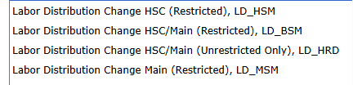
Salary Changes
There are two ways to change WHERE a person is charged (to which indices).
The term “Labor Distribution” means – where is the labor/time/effort allocated.
PHAREDS – change the Past
ePAF – changes the Future
In Banner, there is the PHAREDS screen
In Loboweb, there is the Labor RE-Distribution screen (we are trying to redistribute where a person was charged)
In Loboweb, an EPAF must be submitted – these are the options.
Payroll Adjustment Form - PAF
This is another change to payroll but is typically only to change the AMOUNT paid to the person (not where they are paid)
A missed timesheet entry – we have to pay the person after the payroll period has posted
Back-pay due to the person– if we have missed the payroll deadline, we can create a PAF to provide back pay to the person
Faculty member was supposed to have a teaching overload processed for the Fall. It was not processed until September, and they did not receive their August pay for the course. We would process a PAF to pay what they are due for August.
https://payroll.unm.edu/timeentry.html

Slide 39
ePAF – which type to select
Labor Distribution Change HSC (Restricted) -would be used if the person you are trying to change has either all HSC restricted indices or a combination of HSC unrestricted and restricted indices. This person has NO Main campus indices. This will auto-populate the HSC C&G approvers on the EPAF screen.
Labor Distribution Change HSC/Main (Restricted) - would be used if the person you are trying to change has either all restricted indices or a combination of Main campus & HSC unrestricted and restricted indices. This will auto-populate the Main campus C&G & HSC C&G approvers on the EPAF screen.
Labor Distribution HSC/Main (Unrestricted only) – would be used if the person you are trying to change has ONLY unrestricted indices – regardless if they are HSC or Main campus. These would not require review from C&G.
Labor Distribution Change Main (Restricted) - would be used if the person you are trying to change has either all Main Campus restricted indices or a combination of Main Campus unrestricted and restricted indices. This person has NO HSC indices. This will auto-populate the Main Campus C&G approvers on the EPAF screen.

Slide 40
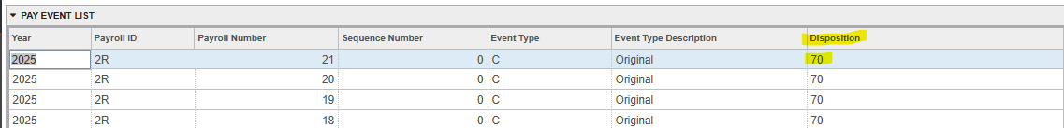
PHAREDS
When you need to change the past allocation for a person, you can process a PHAREDS for them. This can be accomplished in Banner or Loboweb.
In Banner, you can see the payroll periods for the person that you need to change. If a payroll period has completed and posted, it will be marked as “70” under disposition.
In the example above, no changes have been made to 2R21 – as the sequence is “0”.

Slide 41
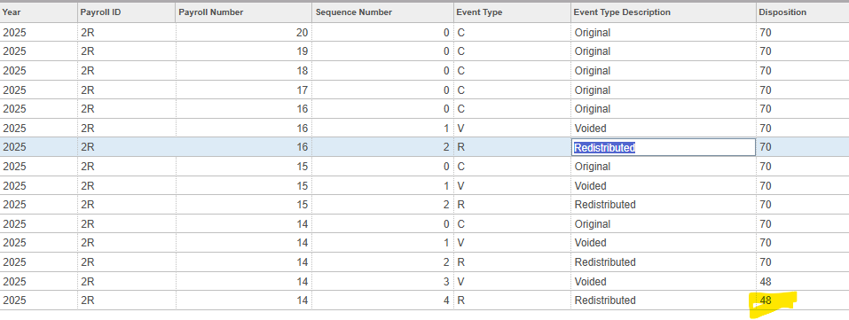
PHAREDS continued
Once a change has been made to a payroll period, you will see a sequence “1” which voids out the original entry (sequence “0”) and then a sequence “2” which replaces the original entry with the changes that were needed. After the PHAREDS has been fully processed, all the dispositions will be “70”.
In the above example, 2R14 has a disposition of “48”
In the above example, payroll 2R14 has been corrected twice – there is a sequence 3 & 4. The disposition is “48” as this redistribution has not been approved by Contracts & Grants yet. If the disposition was “60”, that would mean the redistribution does not touch restricted indices and would only need to be approved by Unrestricted Accounting.
If you see disposition “47”, the means the redistribution has not been submitted and still needs to be finalized/saved and submitted. In “47”, you can make changes still.

Slide 42
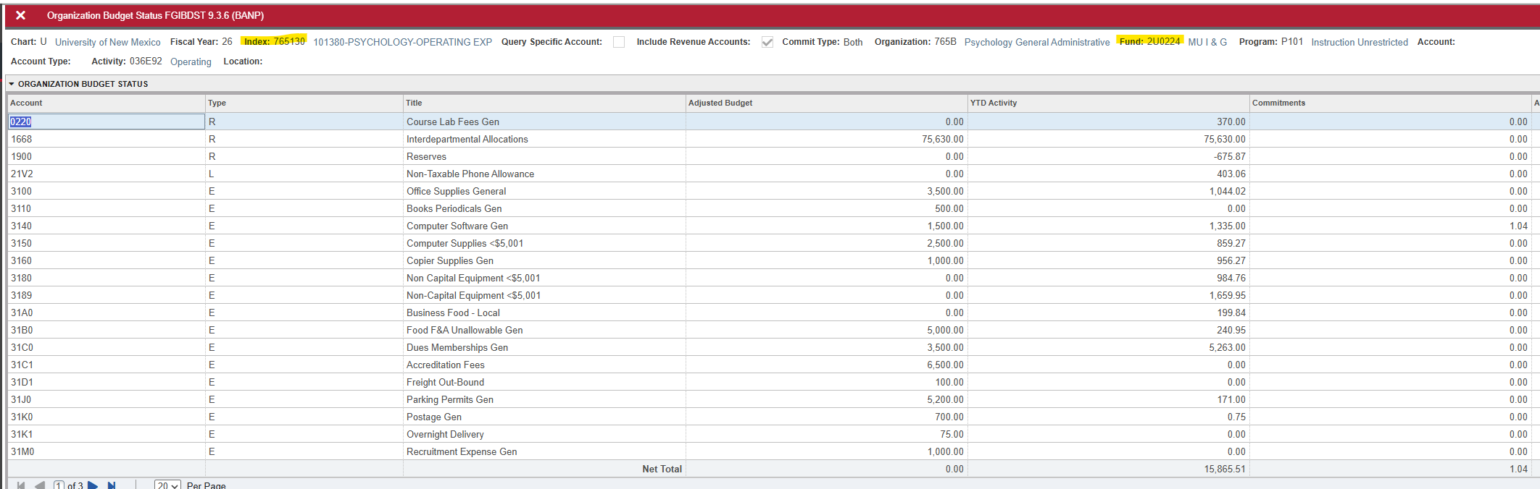
Banner screens - Financial
FGIBDST – Organization Budget Status
I use this screen to look at the budget, actual expenses to date, and encumbrances for my UNRESTRICTED indices.
You can change the fiscal year to look at prior years – this is helpful when looking at projections or planning the future by looking at the trends of the past

Slide 43
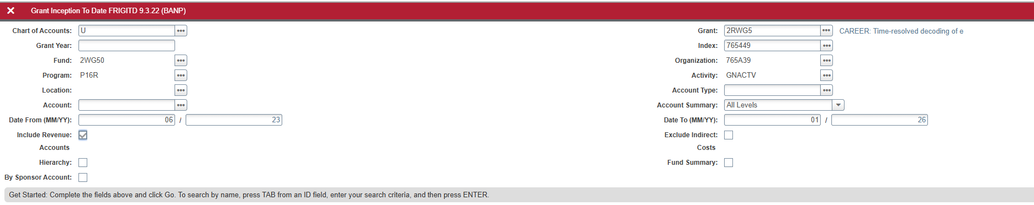
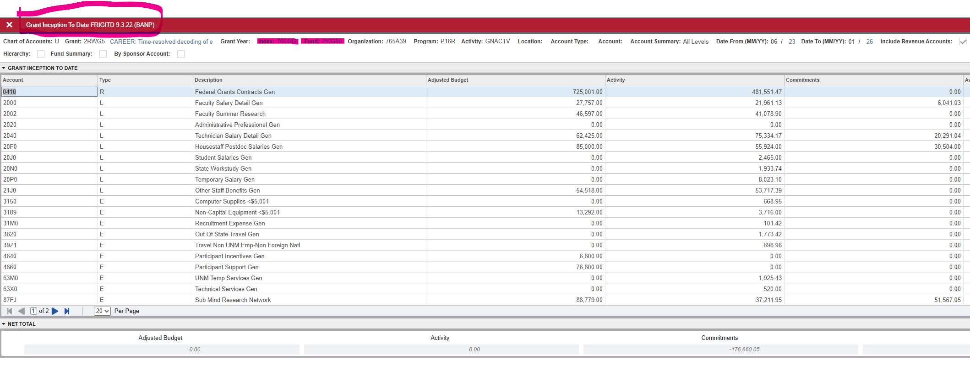
Banner screens – Financial
FRIGITD – Grant Inception to Date
I used this screen to I use this screen to look at the budget, actual expenses to date, and encumbrances for my RESTRICTED indices (grants, contracts, etc).
You can search from inception to date, just one month, a range of months
I typically search by INDEX
The “include Revenue: checkbox is helpful to see how much we have invoiced for a time period
If you choose to search by GRANT number (versus index), a helpful checkbox might be the “Funds Summary” as it will SUM all of the indices in a fund together and then you can scroll through each fund within the grant.
**If you are searching by index – tab through to the index box, enter the index, and then hit tab twice to ensure the correct FOPAL elements populate**

Slide 44
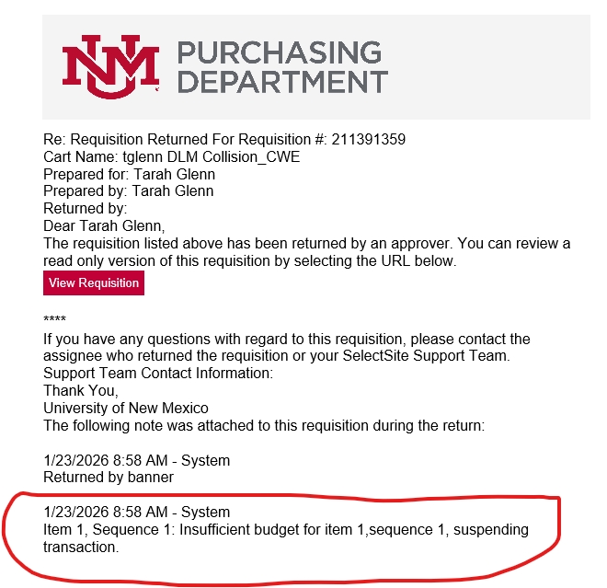
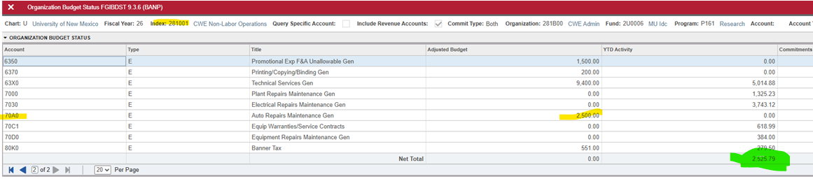

NSF – Insufficient Funds
UH-OH – you tried to submit a requisition in lobomart and get this error
You go to FGIBDST and see that the index has the budget available overall and in the account code line. The index also has funds available in totality
Purchasing may say that sequence 1 or item 1 does not have the budget – this DOES NOT mean the account code does not have the budget as that is not what they see on their screen. Purchasing does not operate at the granular level of account code budgeting.
Insufficient Funds SOP
Microsoft Word - NSF 101_Troubleshooting Rev120325

Slide 45
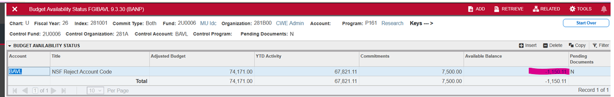

NSF – Insufficient Funds
Now you need to check FGIBAVL to see if your FUND has sufficient budget. FGIBAVL is what Purchasing/Lobomart uses to determine if a FUND has sufficient budget and funds available. This means that FGIBAVL most likely will NOT match FGIBDST as it will be adding ALL indices in your organization that fall under that FUND.
In this scenario, FGIBAVL is adding two indices together – 281000 and 281001 to determine NSF status. Even though 281001 has budget and funds available, because FUND 2U0006 under ORG 281B00 is in a negative overall, 281001 will not be able to process requisitions in Lobomart until the negative is addressed.
This can be done by removing unnecessary encumbrances, moving expenses that perhaps should not have hit one of these indices to a more appropriate index, or by adjusting the Budget for one (or more index) within that FUND.

Slide 46
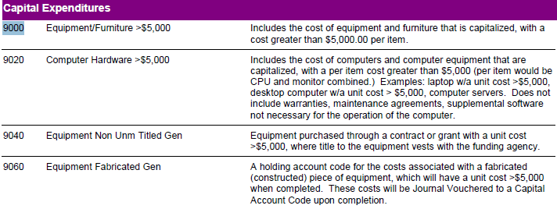
Buying Capital Equipment
What is considered CAPITAL Equipment? It is any singular piece of equipment that costs more than $5,000. There are specific account codes depending on the nature of the purchase.
**Code 9040 is for equipment that will not stay at UNM but instead go back to the agency that provided the funds for it during the grant award period (UNM does not retain ownership of the equipment).**

Slide 47
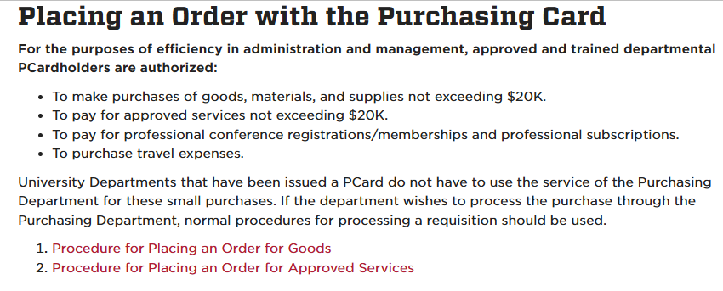
Buying Capital Equipment
You’ve identified the account code but now we need to determine where can you charge this equipment:
Per HED and our UNM policy 7710, unrestricted indices are allowed to be used for a piece of capital equipment not to exceed $10,000. If the item exceeds $10,000, the only index options are restricted/grant/contract funds OR Plant Funds.
https://unmpolicy.policystat.com/policy/17221634/latest/
Keep in mind that larger purchases will be subject to Procurement rules as well.
https://unmpolicy.policystat.com/policy/17221566/latest/

Slide 48
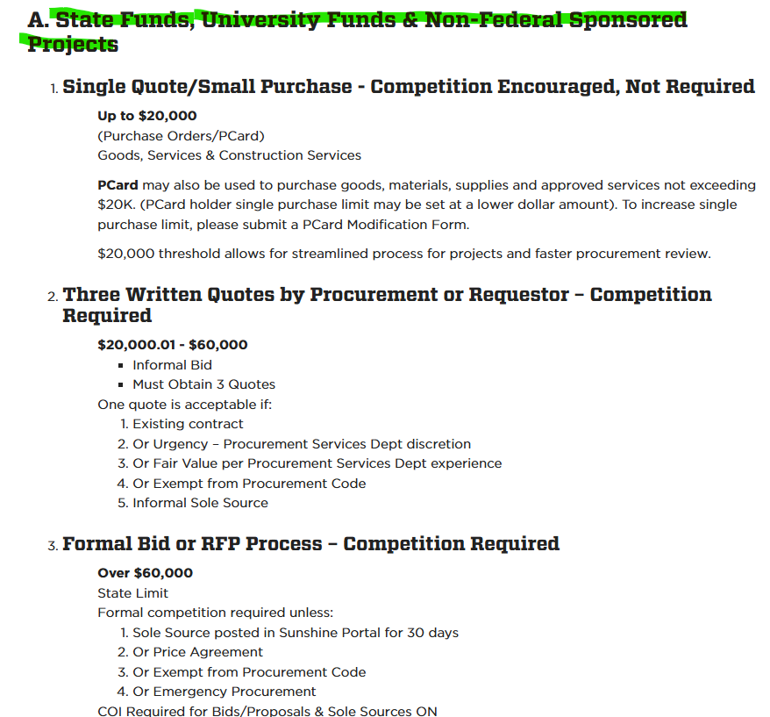
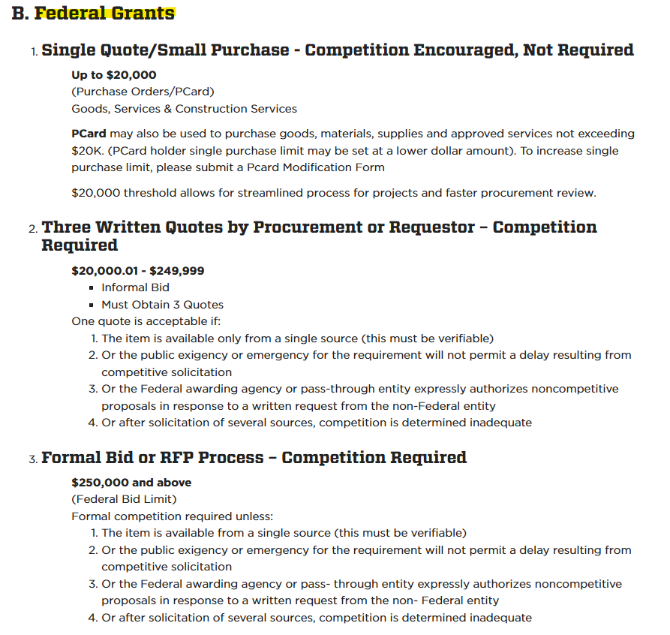
Buying Capital Equipment
https://sarm.unm.edu/part-2/purchasing-and-ap-policies-and-procedures/11-laws-and-regulations-impacting-unm-purchasing.html

