Slide 1

Keeping Research Secure
The Emerging Regulatory Landscape
Presented by: Linda Mayo
Executive Director, ORIC

Slide 2
Why are we talking about research security?
Research security describes the efforts we take to protect our research and our researchers against theft which could be detrimental to publishing efforts, patent efforts, or even national security.
In January 2021, President Trump signed National Security Presidential Memorandum 33 (NSPM-33) which requires research institutions receiving Federal science and engineering funding >$50 million per year to establish and operate a research security program.
Since then….

Slide 3
Agency | Document | Reference | Effective Date
Office of the White House | Presidential Memo on US Government-Supported R&D National Security Policy | NSPM-33 | 14 Jan 2021
United States Congress | CHIPS and Science Act of 2022 | H.R.4346 | 9 Aug 2022
Department of Defense (DoD) | Countering Unwanted Foreign Influence in Department-Funded Research at Institutions of Higher Education | Memorandum for Secretary of Defense for Acquisition and Sustainment | 8 June 2023
Office of Science and Technology Policy (OSTP) | Guidelines for Research Security Programs at Covered Institutions |  | 9 July 2024
Dept. of Energy (DoE) | DoE Financial Assistance Letter | Section 10634(B) of CHIPS and Science Act of 2022 | 1 May 2025
U.S. Dept. of Agriculture (USDA) | America First Memo for USDA Arrangements and Research Security | Secretary’s Memorandum SM 1078-014 | 8 July 2025
National Science Foundation (NSF) | Updates to NSF Research Security Policies | Important Notice 149 | 10 Oct 2025
National Institutes of Health (NIH) | Requirement to Train Senior/Key Personnel on Other Support Requirements | NOT-OD-25-133 | 1 Oct 2025
Department of Justice (DOJ) | Preventing Access to U.S. Sensitive Personal Data and Government-Related Data by Countries of Concern | RIN 1124-AA01 | 6 Oct 2025

Slide 4
NSPM-33
Published in January 2021
Directed at Federal funding agencies to develop standardized policies and practices and to establish Research Security programs that will aim to provide training and disclosing information to combat foreign government interference and exploitation.

Slide 5
CHIPS Act 2022
CHIPS (Creating Helpful Incentives to Produce Semiconductors) isn’t only about the production of semiconductors.
Within the 394 pages of the CHIPS Act, Title VI, Subtitle D (Research Security) prohibits participation in any malign foreign talent recruitment program (also referred to as MFTRPs) by individuals involved with Federal research and development awards.
Section 10634 of the Act refers back to NSPM-33 further emphasizing the requirement for a Research Security program that includes security training in:
cybersecurity
international collaboration and travel
foreign interference
rules of proper use of funds
disclosure of conflict of interest and commitment
export control
Malign = sponsored by a foreign “country of concern”
https://www.state.gov/countries-of-particular-concern-special-watch-list-countries-entities-of-particular-concern

Slide 6
DoD Malign Foreign Talent Recruitment Programs
Countering Unwanted Influence in Department Funded Research at Institutions of Higher Education
Prohibits participation in MFTRPs – effective 8/9/2024
See President Stokes’ memo dated 7/23/2024: https://handbook.unm.edu/filestore/file:5y1XuURq

Slide 7
Office of Science and Technology Policy (OSTP)
Research Security Programs Standard Requirements
Research organizations must fully establish a Research Security program.
Research Security Program will include Cybersecurity, Travel, Foreign Influence, Export Control.
Self-certification will take place on sam.gov on an annual basis.
Research Organizations must designate a Research Security point of contact and provide publicly accessible means to contact that individual.
Research organizations must have an international travel policy for Individuals engaged under federally funded R&D who are traveling internationally for organizational business, teaching, conference attendance, research purposes, or who receive offers of sponsored travel.
Policy must include maintenance of records of covered individuals international travel, record of a disclosure and authorization requirement in advance of international travel, and record of traveler receiving a foreign travel briefing.

Slide 8

US Dept of Agriculture
Issued July 8, 2025 - Updates Terms & Conditions of Award
Applies to USDA R&D and science and technology awards
Complete a Common Form for Current and Pending Support and Biosketch
Certify Research Security Training was completed within 1 year prior to date of award and is recertified annually
Prohibitions on contracts/ agreements for material/non-material benefit with persons or entities with foreign ownership, control, or influence by a country of concern or foreign adversary
Also includes:
  Certification on forced labor
  Annual disclosure of contracts with foreign governments, FTRPs, etc.,
  Annual disclosure of all current and pending research support
  Annual disclosure of all appointments and positions
  USDA approval for subawards
  Annual disclosure of personnel and country of citizenship working on the project

Slide 9

National Science Foundation (NSF)
Important Notice 149 set effective date of October 10, 2025 for research security and RCR changes originally outlined in draft PAPPG26-1.
Includes new and reiterates requirements for:
Research Security Assessment and Required Recipient Documentation
Research Security Training
Malign Foreign Talent Recruitment Program Prohibition
Malign Foreign Talent Recruitment Program Certification
Foreign Financial Disclosure Reporting (FFDR)
Certification of IHEs Hosting or Supporting Confucius Institutes

Slide 10

NSF Research Security Training
Training must address:
Cybersecurity
International collaboration
Foreign interference
Rules for proper use of funds
Disclosure
Conflict of Interest, Conflict of Commitment
Authorized Organizational Rep (SPO/OSP) must certify the senior/key personnel have completed RS training within 12 months prior to proposal submission.

Slide 11
NSF Continued
Reiterates requirement for an institutional plan for Responsible Conduct of Research (RCR) training to be provided upon request.
Expands RCR subject matter requirements:
Mentor Training and Mentorship
Raise Awareness of Potential Research Security Threats
Federal Export Control Disclosure and Reporting Requirements

Slide 12

National Institutes of Health (NIH)
Requires training for all faculty and researchers identifies as senior/key personnel.
Training focused “on requirement for the disclosure of other support to ensure Senior/Key Personnel fully understand their responsibility to disclose all resources made available to the researcher.”
This includes active and pending support, “whether or not they have monetary value.”
Institutions must:
Implement Disclosure Training focused on research activities and affiliations, both active and pending, including access resources made available.
Maintain an enforced written policy for disclosure training.

Slide 13
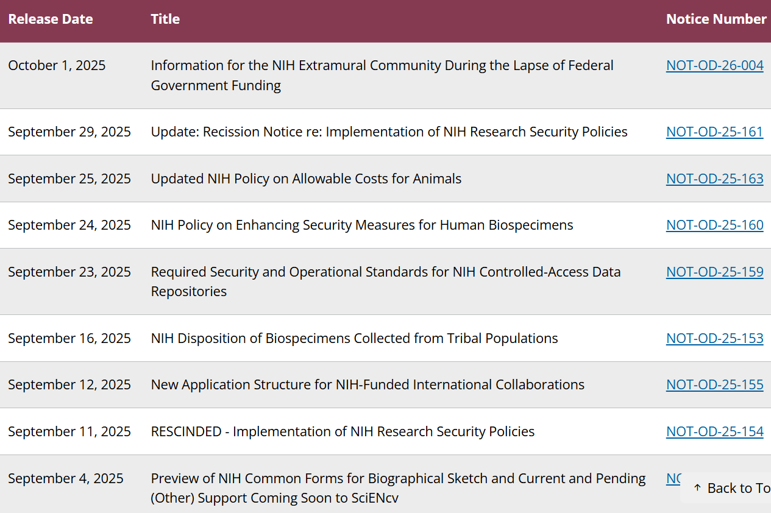
NIH Continued
On 9/11/25, NIH issued notice NOT-OD-25-154 requiring RS training effective 1/25/2026.
On 9/29/25, NIH issued a recission notice NOT-OD-25-161 to rescind the above notice.
Just since September 4, NIH has issued 9 policy changes.

Slide 14
Dept. of Justice Bulk Data Transfer Rule
Why?
  Sensitive U.S. data increasingly flows to foreign-owned or controlled entities (e.g., TikTok)
  Adversaries can aggregate “innocent” datasets into powerful intelligence tools
  Adversary access = unfair advantage in biotech, AI, drug development
  EOs under last two administrations direct DOJ to consider this “national emergency”
  Source: https://www.justice.gov/nsd/data-security

Slide 15
What is the rule?
Defines “country of concern” and “covered person”
Prohibited:
  “no U.S. person […] may knowingly engage in a covered data transaction involving data brokerage with a country of concern or covered person.”
  “no U.S. person […] may knowingly engage in any covered data transaction with a country of concern or covered person that involves access by that country of concern or covered person to bulk U.S. sensitive personal data that involves bulk human `omic data, or to human biospecimens from which bulk human `omic data could be derived.”
Restricted:
  “no U.S. person […] may knowingly engage in a covered data transaction involving a vendor agreement, employment agreement, or investment agreement with a country of concern or covered person unless the U.S. person complies with the security requirements.”

Slide 16
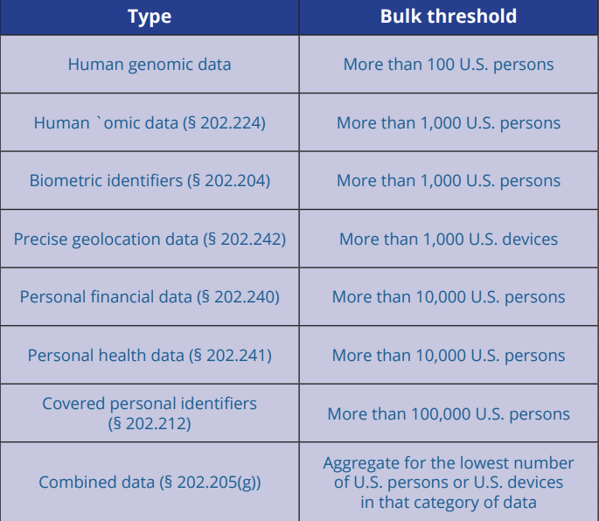
DOJ Continued
Exempted:
Personal Comms • Informational Materials • Travel • USG Official Business • Financial Services • Corporate group transactions • Federal law • Telecommunications • Drug, biologics, or med device authorizations • Clinical investigations and post-marketing surveillance data

Slide 17

How is UNM addressing these requirements?
Established a Research Security Program and website within the Industrial Security Department: https://isd.unm.edu/research-security/index.html
Created UNM-centric Research Security Training hosted in Learning Central
Procedures to verify RST at time of proposal submission
Questions added to Conflict of Interest (COI) disclosure forms
Questions added to proposal and contract questionnaires
Created new FHB Policy E130: Foreign Talent Recruitment Programs
Revised FHB Policy E110: COI in Research to include required training

Slide 18
What’s next?
NIH will issue requirements related to research security training
Federal agencies will continue to issue policies and guidance for foreign interactions
Continued government interest in foreign collaborations and partnerships

Slide 19

Linda Mayo, Executive Director
UNM Office of Research Integrity and Compliance petreel@unm.edu

