Slide 1
UNM Main Campus OFFICE OF EXPORT CONTROL
guidelines for Purchsing, inventory control, and Surplus Property
Research administrators Network Meeting
April 12, 2016

Slide 2
The Life Cycle of UNM Controlled Property
Purchasing
Goal: Identify
Inventory Control
Goal: Document and Manage
University Services
(Surplus Property)
Goal: Appropriately Dispose

Slide 3
Program Structure - A Partnership
The Office of Export Control
Purchasing
University Services
Inventory Control
Departments, Centers and Institutes
Purchasing scientific or technical equipment is essential for the advancement of the University’s research mission.
Together, we are supporting the University's research mission as well as mitigating risk to the institution and our investigators

Slide 4
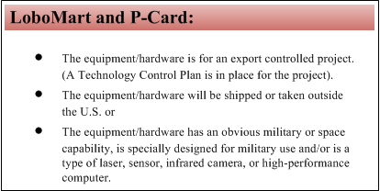
Requisitioner Responsibilities
It is the responsibility of the requisitioner or PCard holder to perform appropriate due diligence in order to determine if the item to be purchased is export controlled if the following conditions apply:

Slide 5
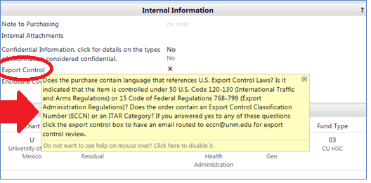
Requisitioner Responsibilities
If the requisitioner determines that the item is export controlled they would select yes LoboMart and an export control review would be conducted.

Slide 6
Key Terms (this is not all inclusive)
Areas of Concern:
Electrical & Computer Engineering
Chemical & Nuclear Engineering
Manufacturing Engineering
Engineering Centers
Computer Science
Physics & Astronomy
Earth & Planetary Sciences
Biology
COSMIAC
Terms to watch for:
Lasers
Sensors
Robotics
Optics
High Level GPS systems
Specialized cameras
Non-commercial software
ECCN- Export Control Classification Number
EAR- Export Administration Regulations
CCL- Commerce control list
ITAR- International Traffic in Arms Regulations
U.S. Munitions List

Slide 7
Purchasing Review of Terms and Conditions
The Purchsing Officer will also conduct a review of the terms and conditions to identify language that may indicate that the item is controlled.
If such language is found- an email will be sent to the Export Control Officer and an export control review will be conducted.

Slide 8
Inventory Control Goal: Document and Manage
If during the export control review it is determined that an item is controlled- the item will be flagged in the Banner system.
A Technology Control Plan will be created to protect the item while it is in our custody.
An annual audit will be conducted to ensure that the item is appropriately controlled.
Notifications will be sent to the Office of Export Control if changes or the identified actions occur. (See flow chart in guidance document for more information)

Slide 9
Technology Control Plan
The Technology Control Plan will include the following elements:
Who has access to the item(s)
Where on campus will the item(s) be located
Export control awareness training

Slide 10
University Services (Surplus Property) Goal: Appropriately Dispose
If it is determined that the item is export controlled, special requirements for the buyer must be met: The special requirements may include:
The buyer must be a U.S Person as defined in 22 CFR 120.15
The buyer must show proof of citizenship in the form of a passport or birth certificate and government issued photo ID.
The buyer must pass an Export Control Debarment Screening
The buyer must have subject matter knowledge of the item to be purchased
All special requirements must be met before the item will be released to the buyer. If the buyer does not meet with special requirements the item will become available to the next highest bidder.

Slide 11
Development and Training Phases
Phase 1
Process Development
Phase 2
Buisness Office Training
Phase 3
Departmental Training

Slide 12
Q & A
Thank you

